Slide 1


CAMS
Composite Agile (CAMS)
Job Aids Repository v2.9
Designed by
Bhuvan Unhelkar, PhD, FACS, CBAP
bhuvan@MethodScience.com
Cell:+1 (941) 404-4406
Agilist’s
Toolbox
Notes:
Your Name: -------------------------------

Slide 2
Job Aids for Agile Practices (Aligned with CAMS)
[1] User Story (Features)
[2] User Persona
[7] Iteration Planning
[3] Prioritization (MoSCoW)
[10] Show Casing
[4] Estimation
[6] Capability Analysis
CAMS
Pre-Iteration
Post-Iteration
[8] Visible Charting
[9] Backlog Management
[11] Retrospective
[5] Team Formation
[12] Continuous Testing
[13] Daily Stand-up Meeting
Core – Within Iteration
Notes:
We will learn and use these Agile Practices throughout the Course. We will open relevant Job Cards to remind us of the practices.
CAMS – stands for Composite Agile Method and Strategy – and is described in greater detail on Day 2.

Slide 3

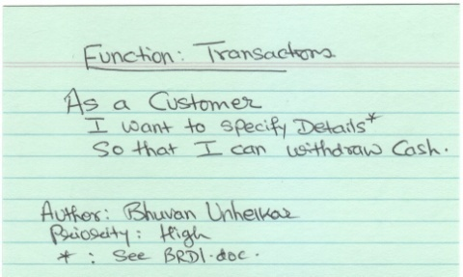

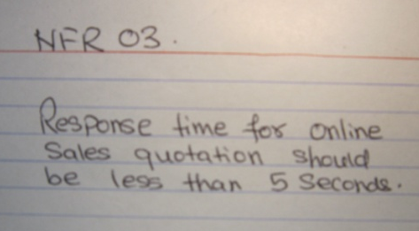
User Story / Features
1
Job Card
WHAT: A verb-like description of Requirement to enable Conversation; Occasionally Features & Tasks;
WHEN: During Requirements Elicitation (Functional & Non-Functional)
HOW: Requirements Elicitation Workshops; Handwritten; On Wall; Related to Epics & Themes;
METRICS: Stories per Iteration;
CAVEAT: Non-testable Stories; Ignoring Non-Functional; Overwhelming details;
User Story (Story Card)
Short sharp Requirement Statement
© www.MethodScience.com/JobAids
version 3.0
Checkout the short Video Update
Notes:
January 14, 2018
(c) Thomson Publishing, 2005: Practical OO Design: Figures - Chapter 8 - Implementation© MethodScience, 2001-05, All Rights Reserved
www.MethodScience.com
Page: 3
Short Title with Active Verb – the title of the story should be at most 5 words, and should contain an active verb. If the title cannot be kept to around 5 words, then the story likely needs to be split into multiple stories.
Estimable – The developers should be able to understand the story well enough to provide a reasonable estimate. If they can't, the story should be split or rewritten in order to make it simple enough to be estimated.
Testable – A story should be simple enough for the team to create automated tests to verify it. If not, it probably needs to be split. Note as well that quite often there is more than one acceptance test per story.
Written by the Product Owner - The Story authors may be the Product Owner or their Proxy, Domain or Subject Matter Experts, or possibly even the Stakeholders. However, the important point is that people from the Business are the authors of the User Stories.

Slide 4

User Persona
2
Job Card
WHAT: Profile of a User Group Representative (Actor); Also Team Roles
WHEN: During Stakeholder Analysis / Requirements Elicitation
HOW: Create Persona per Demographic; (Real and Virtual); Assign Icon, Initials
METRIC: Total User Representatives (Actors)
CAVEAT: Changing Personas; Mixing Team Roles with End-User Roles; Incomplete Influence/Interest Matrix;
User Persona
User (Actor) Analysis
User
Customer
Borrower
Staff
© www.MethodScience.com/JobAids
version 3.0
Checkout the short Video Update
Notes:
January 14, 2018
(c) Thomson Publishing, 2005: Practical OO Design: Figures - Chapter 8 - Implementation© MethodScience, 2001-05, All Rights Reserved
www.MethodScience.com
Page: 4

Slide 5
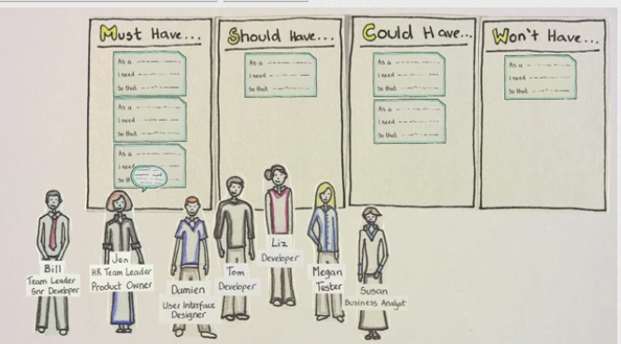

Prioritization (MoSCoW)
3
Job Card
WHAT: Setting Priorities on Stories / Product Backlog items
WHEN: Daily Standup; Iteration Planning; Ongoing (extreme)-All the time
HOW: Team Members select MSCW per story (or Epic); Discuss for Consensus
METRIC: Total Cards per Priority; Rate of Change of Priorities;
CAVEAT: Disagreements or Uncertainty amongst team (put item on hold)
Prioritization
Must, Should, Could & Wont have Priorities
© www.MethodScience.com/JobAids
version 3.0
Checkout the short Video Update
Notes:
January 14, 2018
(c) Thomson Publishing, 2005: Practical OO Design: Figures - Chapter 8 - Implementation© MethodScience, 2001-05, All Rights Reserved
www.MethodScience.com
Page: 5

Slide 6
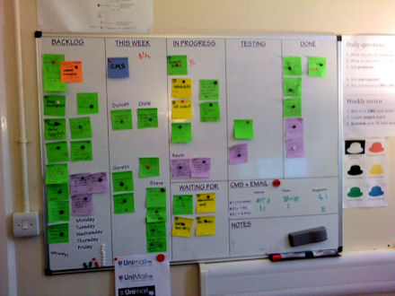
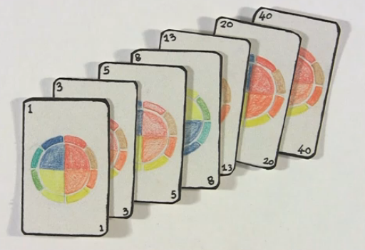
Estimation (Planning Poker; Delphi)
4
Job Card
WHAT: Group Exercise to Estimate and assign effort in User Stories
WHEN: During Each Iteration Planning
HOW: Write Estimates (based on priorities); Reveal; Discuss and Build Consensus .
METRIC: 1-3-5-8-13-20-40; Can apply to Affinity areas; Feedback in Next Iteration
CAVEAT: Treating it as a Vote rather than Consensus building; Applying rigorously to High Risk items (that need a Veto);
Estimation (Planning Poker)
Game to Estimate & Plan work
Fibonacci Sequence (Modified)
Named after Leonardo of Pisa
© www.MethodScience.com/JobAids
version 3.0
Checkout the short Video Update
Notes:
January 14, 2018
(c) Thomson Publishing, 2005: Practical OO Design: Figures - Chapter 8 - Implementation© MethodScience, 2001-05, All Rights Reserved
www.MethodScience.com
Page: 6

Slide 7

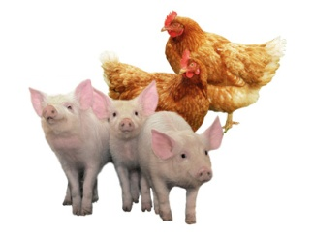
Team Formation
5
Job Card
WHAT: Organize Agile Team – Nominate people to Roles
WHEN: Start of Agile Project; When Team Members change;
HOW: Assign Agile Coach; Product Owner; Team Members; Ensure Cross-functional Stakeholders; Co-located;
METRIC: Committed (Pigs) and Observers/ Interested (Chickens);
CAVEAT: Ignoring roles from Planned methods (e.g. BA; EA); Fixation!
Team Formation
Cross-Functional, Co-located
Agile Product Domain
Coach Owner Expert
Team x Business Enterprise
Members Analyst Architect
© www.MethodScience.com/JobAids
version 3.0
Checkout the short Video Update
Notes:
January 14, 2018
(c) Thomson Publishing, 2005: Practical OO Design: Figures - Chapter 8 - Implementation© MethodScience, 2001-05, All Rights Reserved
www.MethodScience.com
Page: 7

Slide 8

Capability Analysis
6
Job Card
WHAT: Alignment of Project with Business Strategies; A Capability Map
WHEN: Strategic Planning; Revisit every Iteration (2-4 Weeks).
HOW: Identify Gaps in Capabilities; Undertake Product scoping; Release Planning; Create Capability (Heat) Map
METRIC: High-Medium-Low: Values; Risks; Gaps; Only Descriptions used.
CAVEAT: No Standard Model; Gap keeps changing.
Capability Analysis
Holistic Business Focus
Values
Risks
High
High
Medium
Medium
Low
Low
© www.MethodScience.com/JobAids
version 3.0
Checkout the short Video Update
Notes:
January 14, 2018
Page: 8

Slide 9


Iteration (Sprint) Planning
7
Job Card
WHAT: Dynamic Plan based on Stories & Resources for Iteration
WHEN: Start of Each Iteration
HOW: Half-day workshop; Solution Development Team mainly;
METRICS: Iteration No; Past Iteration Backlogs; Estimates & Priorities;
CAVEAT: Relying entirely on Iteration plan without Overall Planning
Iteration (Sprint) Planning
For Immediate Iteration
© www.MethodScience.com/JobAids
version 3.0
Checkout the short Video Update
Notes:
January 14, 2018
Page: 9

Slide 10
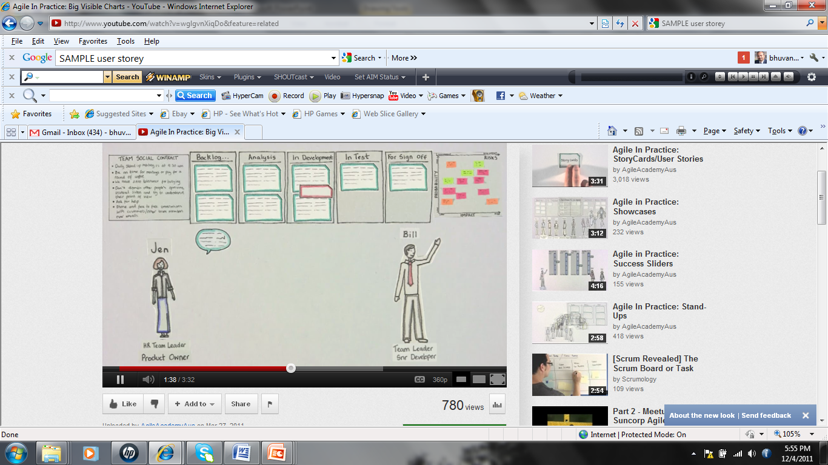
Visible Charting
8
Job Card
WHAT: Public Display of Elements & Progress physically on the Wall
WHEN: Throughout an Agile project
HOW: Product Backlog, User Stories, Prioritization etc. All updated on Charts on Walls throughout the Project
METRIC: Charts per Iteration; Total Charts in a Project; ‘Done’ Charts;
CAVEAT: Keeping charts Current; Ignoring previous project’s Charts
Big Visible Charts
Make Everything Visible
© www.MethodScience.com/JobAids
version 3.0
Checkout the short Video Update
Notes:
January 14, 2018
(c) Thomson Publishing, 2005: Practical OO Design: Figures - Chapter 8 - Implementation© MethodScience, 2001-05, All Rights Reserved
www.MethodScience.com
Page: 10

Slide 11
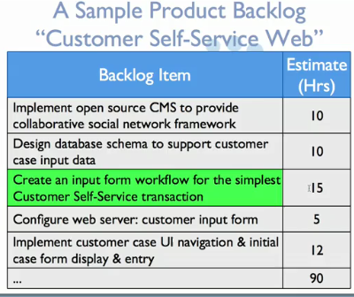
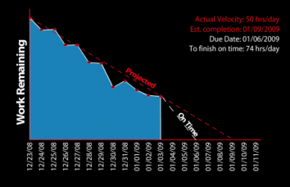
Backlog Management
9
Job Card
WHAT: A variation of the Project Plan, wherein Items and their Time estimated
WHEN: Through out the Agile project and Iteration
HOW: Manage and track Project Control Document.
METRIC: Project (burn down Chart) Velocity
CAVEAT: Non-Uniform Tasks;
Backlog Management
Task Lists & Progress
© www.MethodScience.com/JobAids
version 3.0
Checkout the short Video Update
Notes:
January 14, 2018
(c) Thomson Publishing, 2005: Practical OO Design: Figures - Chapter 8 - Implementation© MethodScience, 2001-05, All Rights Reserved
www.MethodScience.com
Page: 11

Slide 12

Showcasing
10
Job Card
WHAT: A demonstration of the Progress to Product Owner; Work through issues
WHEN: Post Iteration/Sprint, during a Showcase meeting;
HOW: Demonstrate DONE items (executables); Discuss roadblocks; Update Priorities, Estimates
METRIC: 4 hours Time boxed;
CAVEAT: Demonstrating INCOMPLETE items (e.g. PPT demos, not allowed)
Showcasing
Demonstration of Progress
© www.MethodScience.com/JobAids
version 3.0
Checkout the short Video Update
Notes:
January 14, 2018
(c) Thomson Publishing, 2005: Practical OO Design: Figures - Chapter 8 - Implementation© MethodScience, 2001-05, All Rights Reserved
www.MethodScience.com
Page: 12

Slide 13

Retrospective (Post Iteration)
11
Job Card
WHAT: Meeting Feedback on an Iteration/ project for Team Members (Pigs)
WHEN: At the end of an Iteration (or a Project)
HOW: Each Team member to lists What worked/Did not work Well/ To be changed; Facilitated by Scrum Master/ Agile Coach
METRICS: 3 hours; Total Items / Retrospective;
CAVEAT: Not Documenting Post Implementation Discussion; No reuse;
Retrospectives
Reflection on Iteration
© www.MethodScience.com/JobAids
version 3.0
Checkout the short Video Update

Slide 14

Continuous Testing
12
Job Card
WHAT : Ongoing Testing of Software Product; Functional & Non-Functional.
WHEN : Within Sprints; Iteration-end
HOW: Write Test Harnesses; Ensure Valid & Invalid Test Data;
METRICS: Bugs per Story;
CAVEAT: Don’t forget eventual Integration Test with dependencies.
Continuous Testing
V&V of Software & Models
© www.MethodScience.com/JobAids
version 3.0
Checkout the short Video Update
Notes:
January 14, 2018
Page: 14

Slide 15
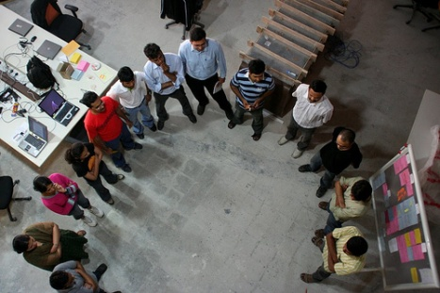
Stand-up Meeting
13
Job Card
WHAT: A Daily Meeting of ALL team members to speak THREE things – What is achieved, What is planned, and Roadblock?
WHEN: 9:30AM, Every day – Facilitates Collaboration / Communication
HOW: Limit to 15 minutes; Has to be Standup; Ensure Cross-Functionality; Notes by Agile Coach alone.
METRIC: Meetings per Iteration ; missed
CAVEAT: Being Pedantic about Standup; (e.g. In an Outsourced Project; Phone call); Degenerates into Task Management!
Stand-up Meeting
A Collaborative Event
© www.MethodScience.com/JobAids
version 3.0
Checkout the short Video Update
Notes:
January 14, 2018
(c) Thomson Publishing, 2005: Practical OO Design: Figures - Chapter 8 - Implementation© MethodScience, 2001-05, All Rights Reserved
www.MethodScience.com
Page: 15

